Slide 1
TDD with Mocha

Slide 2
TDD introduction
Test-driven development (TDD) is agile development techniques.
TDD for quality of code, faster development resulting from greater programmer confidence, and improved bug detection.
The behavior-driven development (BDD) concept is based on TDD which encourages collaboration between product owners and programmers.

Slide 3
TDD introduction
Other TDD unit testing Frameworks :
NodeUnit (http://pivotal.github.com/jasmine)
Jasmine (http://pivotal.github.com/jasmine)
Vows (http://vowsjs.org)

Slide 4
TDD with Mocha
Mocha is a mature and powerful testing framework for Node.js.
npm install –g mocha
mocha –Version (check – 2.3.2)
TDD Steps :
Define a unit test
Implement the unit
Verify that the test passes

Slide 5
TDD with Mocha
$ mocha [options]command takes:
-h or --help: print help information for the Mocha command
-V or --version: print the version number that’s being used
-r or --require <name>: require a module with the name provided
-R or --reporter <name>: use a reporter with the name provided
-t or --timeout <ms>: set the test case time out in milliseconds

Slide 6
TDD with Mocha
$ mocha [options]command takes:
-w or --watch: watch test files for changes on terminal
-c or --colors: enable colors (-C – no colors)
--debug-brk: enable the Node.js debugger breaking
-b or --bail: exit after the first test failure
-A or --async-only: set all tests in asynchronous mode
--recursive: use tests in subfolders
--globals <names>: provide comma-delimited global names
--reporters: print available reporters

Slide 7
TDD with Mocha
Mocha supports more traditional TDD interfaces:
suite: analogous to describe
test: analogous to it
setup: analogous to before
teardown: analogous to after
suiteSetup: analogous to beforeEach
suiteTeardown: analogous to afterEach

Slide 8
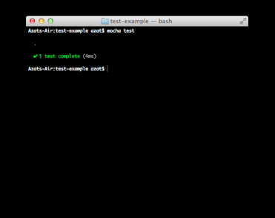
TDD with Mocha
//assert module is built-in node mocha\test.js
var assert = require('assert');
describe('String#split', function(){
it('should return an array', function(){
assert(Array.isArray('a,b,c'.split(',')));
});
})
$ mocha test
….
1 passing (16ms)

